Slide 1



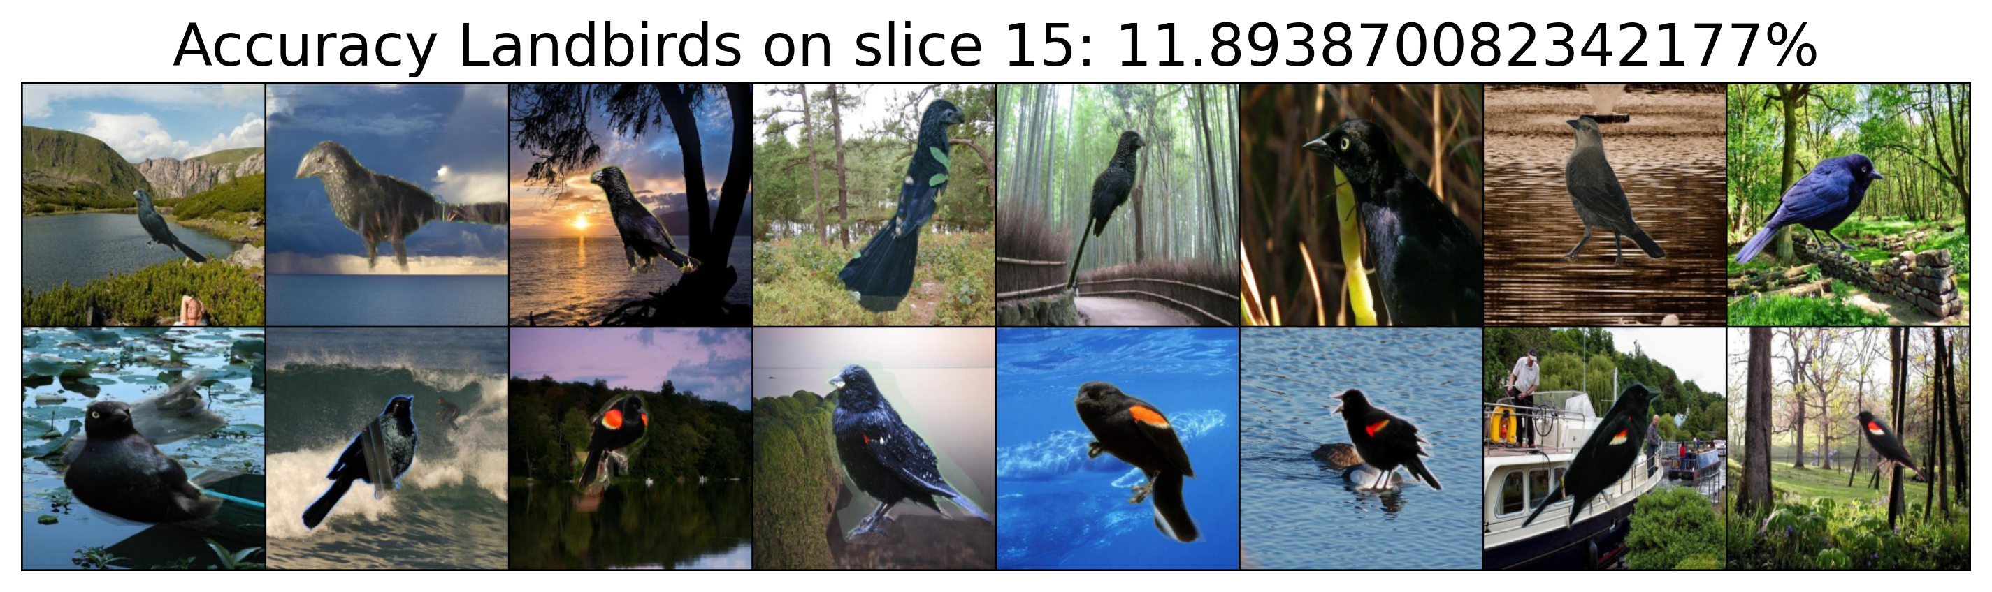





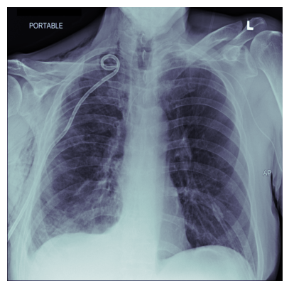
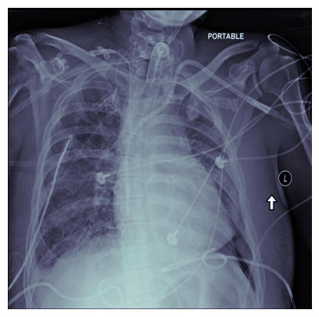
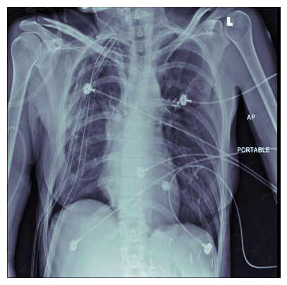
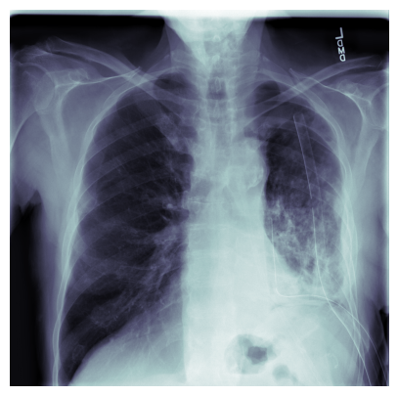
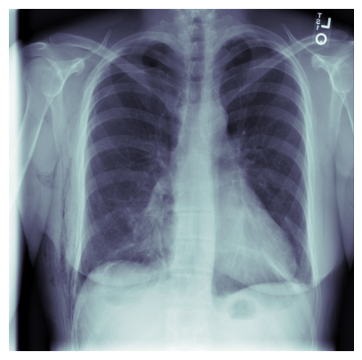
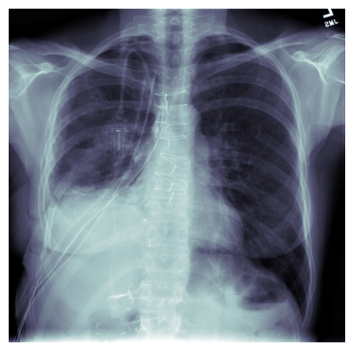
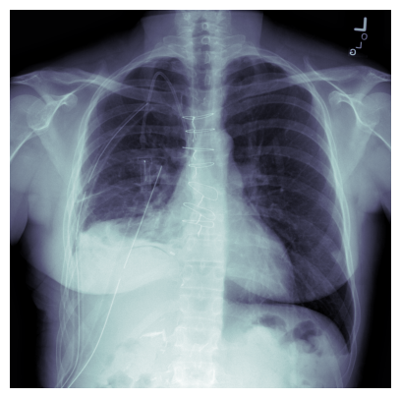
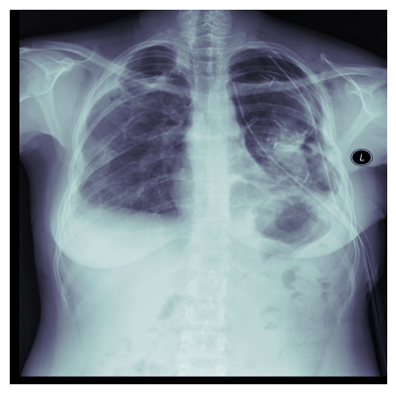
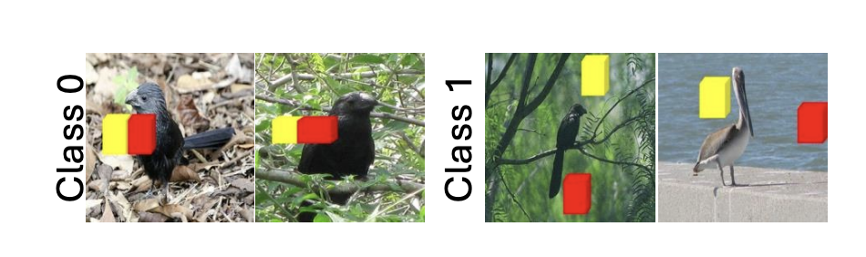
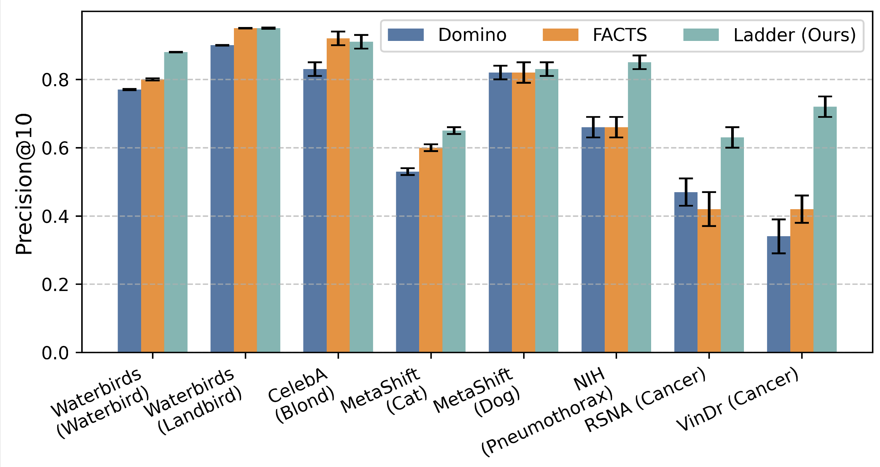
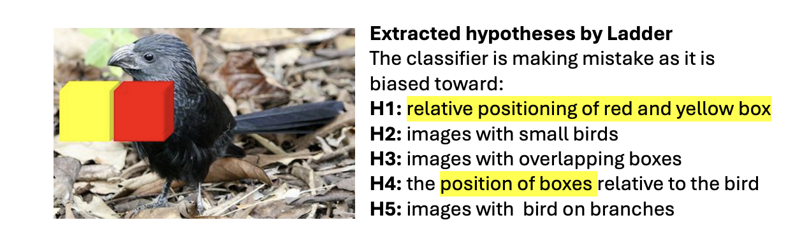
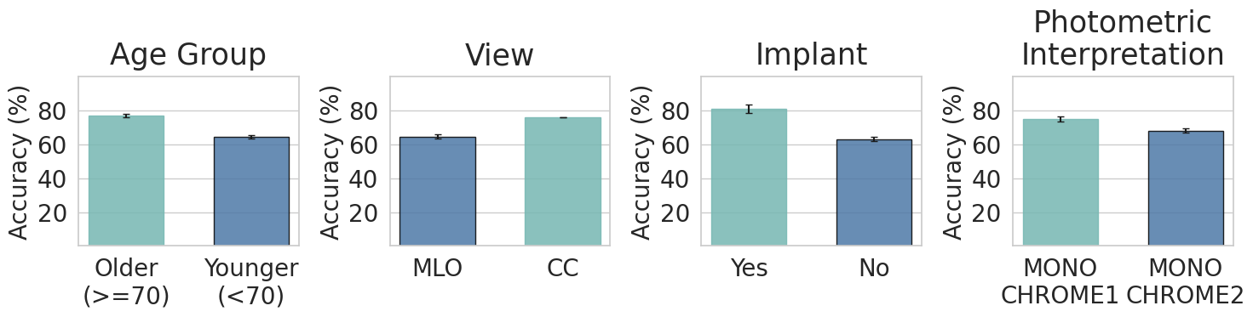

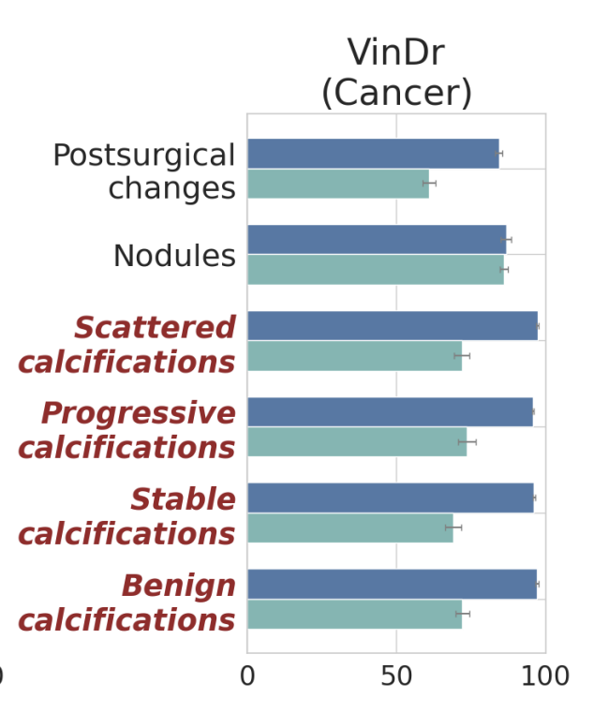
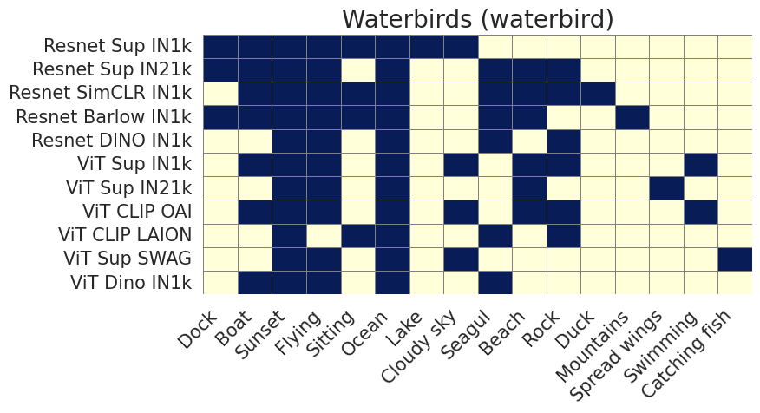
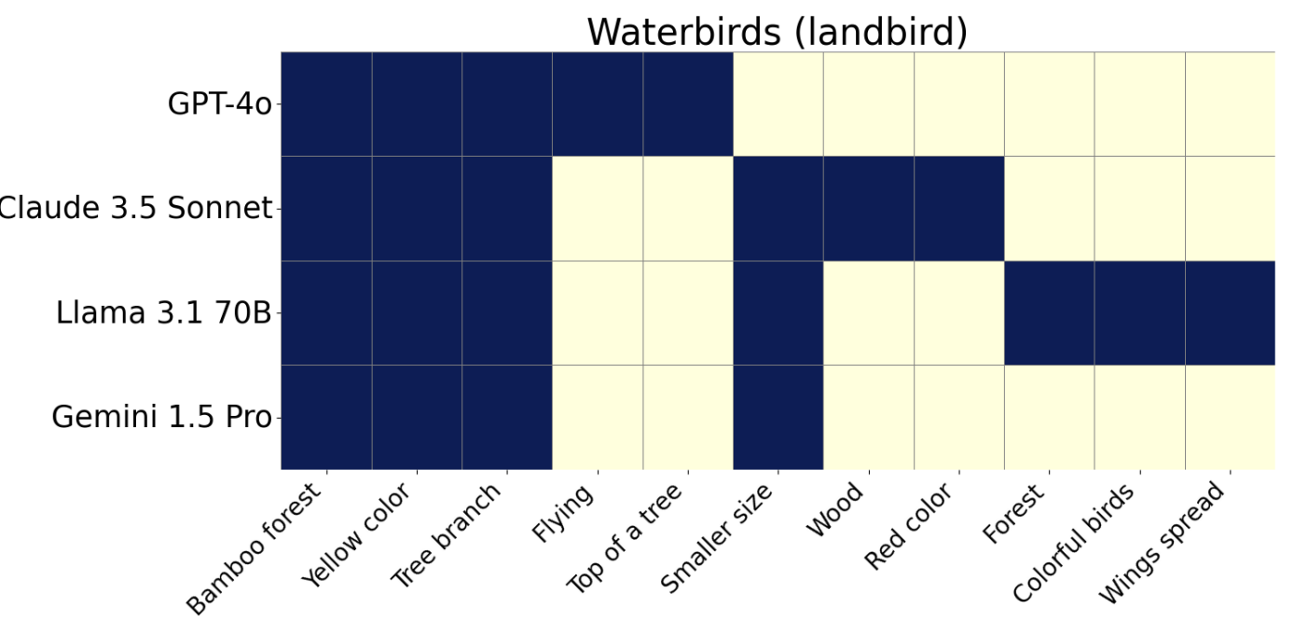
LADDER: Language-Driven Slice Discovery and Error Rectification in Vision Classifiers
Shantanu Ghosh¹, Rayan Syed¹, Chenyu Wang¹, Vaibhav Choudhary¹, Binxu Li², Clare B. Poynton³, Shyam Visweswaran⁴, Kayhan Batmanghelich^{1,2}
¹Dept. Of Electrical and Computer Engineering, Boston University. ²Stanford University. ³Boston University Chobanian & Avedisian School of Medicine
³Intelligent Systems Program (ISP), University of Pittsburgh
What is Slice discovery methods (SDMs)?
Identifying coherent subsets of data that exhibit higher systematic error than the overall dataset.
Challenges in existing SDMs
Unsupervised slice discovery does not maintain coherence
Supervised slice discovery needs objects to be annotated
3. Existing slice discovery algorithms does not have reasoning
4. Not utilizing domain knowledge, needed for medical imaging
5. Only visual biases are detected
13
15
Overall Accuracy of the dataset: 88%. Accuracy of Landbird class: 83%
Landbird on water
accuracy: 68%
(Detected by DOMINO)
Our contribution
Incorporate reasoning in SDM using LLM
No external annotations
Detecting beyond visual slices
TL;DR: LADDER uses LLMs to identify slices with higher systematic errors, w/o requiring annotated bias attributes or group labels. Unlike the traditional methods, it identifies both visual and non-visual sources of bias, enabling interpretable diagnosis across the vision pipeline.
Tracing Bias with LLM, going beyond visual biases
Population
Individual
Data
AI Risk Model
Age: [32-88]
Race: 80% Non-Hispanic White,
20% Asian
Reason for Visit: [ ….]
Blood Pressure: […]
Lab Test: [….]
Manufacturer: [ ….]
X-ray Dosage: […]
Aperture Setting: [….]
AI Explanation: AI model identifies calcification on the left breast and 2mm mass on right breast …
LADDER
Hypothesis: chest tubes
Slices
Correct
+
Classifier
Correct
[“Chest X-ray with
chest tubes”, ..]
Incorrect
Incorrect
Patient Data (EHR)
Metadata (e.g, DICOMS)
1. there is little change in the 3 left chest tubes with area of hydro pneumothorax
2. with chest tube remaining in place and no striking change
LLM
LLM
Manufacturer: [ ….]
X-ray Dosage: […]
Aperture Setting: [….]
Hypothesis: fluid levels
Age: [ ….]
Blood Pressure: […]
Lab Test: [….]
+
[“Chest X-ray with high fluid levels”, ..]
Qualitative result
Quantitative result
More in our paper
Utilization of LLM-based reasoning
✅ 200+ Classifiers
📁 6 Datasets Used
🚀 GPT-4o as primary LLM
🧠 Using LLaVA to eliminate the
need of captions/reports.
Synthetic
Dataset w/ box
positioning bias
🤖 Ablations
🧠 4 LLMs
🕵️‍♀️ 2 SDMs
🧹 12 Mitigation methods
LADDER correctly
detects the
positioning bias
Detecting beyond visual biases
Resources
Utilization of LLM’s domain knowledge
LADDER correctly
detects disease subtype bias
Biases across architectures
Biases across LLMs

